Slide 1
The Floor Planning Problem:
A Convex Optimization Approach
ECE 509: Convex Optimization Final Project Presentation
Mingju Liu
mingju.liu@rutgers.edu

Slide 2
Overview
Problem Statement
Model Formulation
Geometric Programming Approach for Optimization
Result & Analysis
Conclusion
References

Slide 3
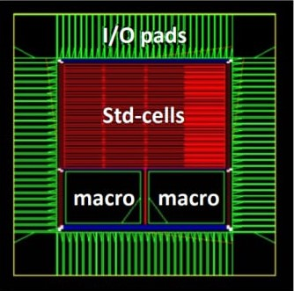
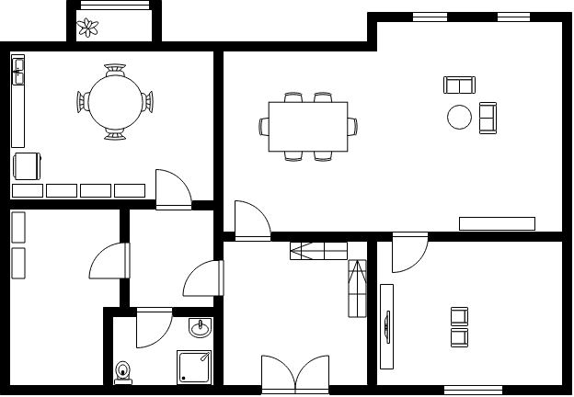
Problem Statement
This problem has important applications in fields such as architecture and VLSI design.
In architecture, the floor is usually fixed, so the objective would be to arrange rooms so that they cover the whole area and satisfy the constraints.
In VLSI design, our goal is to place each block to minimize the area of the chip while respecting certain placement constraints.

Slide 4
Model Formulation
We will consider the VLSI design part in this project…
Parameters:
Wi: width of ith block
Hi: height of ith block
W: width of the whole area
H: height of the whole area
Ɑ: Aspect ratio of the blocks
(xi, yi): coordinate of the lower left corner of the ith block
Equations:
WH: the whole area
hi/wi: aspect ratio

Slide 5
Module Formulation
In general, this problem is a complicated combinatorial optimization problem.
To Simplify we can minimize the perimeter of the whole area not just the area to make it as a convex function. Minimize 2(W+H)
We will consider many constraints: Relative position, alignment of blocks, symmetric blocks, similarity between blocks, containment and distance between blocks. (In Text)
However, if we can specify the relative position between blocks, we can formulate this problem as a GP (GGP) problem.
Let’s say four blocks, A, B, C, D
A is to the left of B.
C is to the left of D.
A and B are above C and D.

Slide 6
GP (GGP) Approach
W = max{wA + wB, wC + wD}
H = max{hA, hB} + max{hC, hD} → Generalized Posynomial
So the objective function and constraints are:
Minimize WH
Subject to hAwA = a,
hBwB = b,
hCwC = c,
hDwD = d,
1/ɑ ⪬ hA/wA ⪬ ɑ, …
Consider ɑ as a controlled parameter

Slide 7
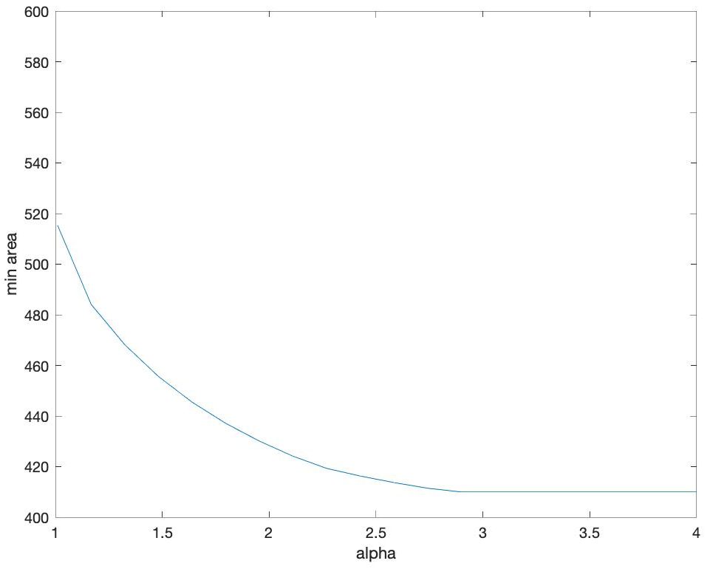


Results & Analysis
Perturbed Problem: We choose ɑ = (1.01:20:4)
Block size: 30 150 30 200
GPsolver: ɑ = 2
Min_area = 428.2624

Slide 8
Conclusion
A GP-based optimization approach to Floor Planning is provided.
With a loosen enough constraint on as aspect ratio, the blocks can configure themselves so that they give a perfect packing -- no unused space inside the bounding box.
Some thoughts:
We need add other constraints to the problem to generate the relative position.
We can implement the floor planning problem using the MCNC benchmark to make it more complicated and more general.

Slide 9
References
Chaomin Luo, M. F. Anjos and A. Vannelli, "Large-scale fixed-outline floorplanning design using convex optimization techniques," 2008 Asia and South Pacific Design Automation Conference, Seoul, 2008, pp. 198-203.
Ying-Chieh Chen, Yiming Li, “Temperature-aware floorplanning via geometric programming”, Mathematical and Computer Modelling 51(2010)927-934
Boyd, Stephen, et al. "A tutorial on geometric programming." Optimization and engineering 8.1 (2007): 67

Slide 10
Thanks!

